Slide 1
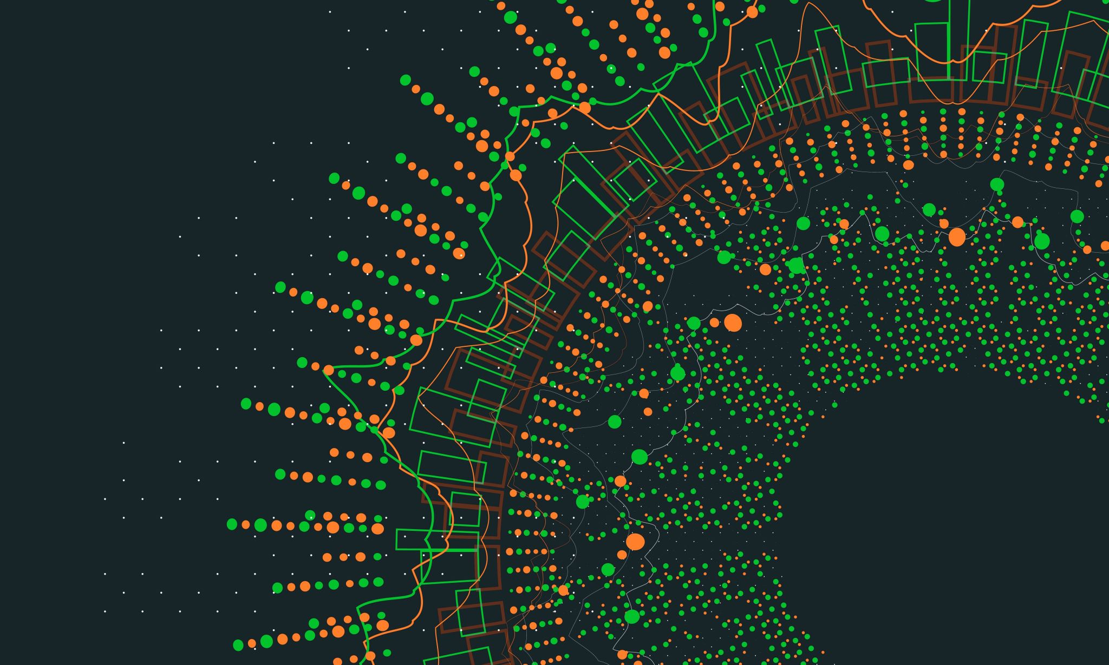

Fanatical Drafting’s of Realities Fantasies
Team Owners/General Managers:
Johnny Capra, Jacob Pos, Necole Barnes, & Ian Morrison

Slide 2
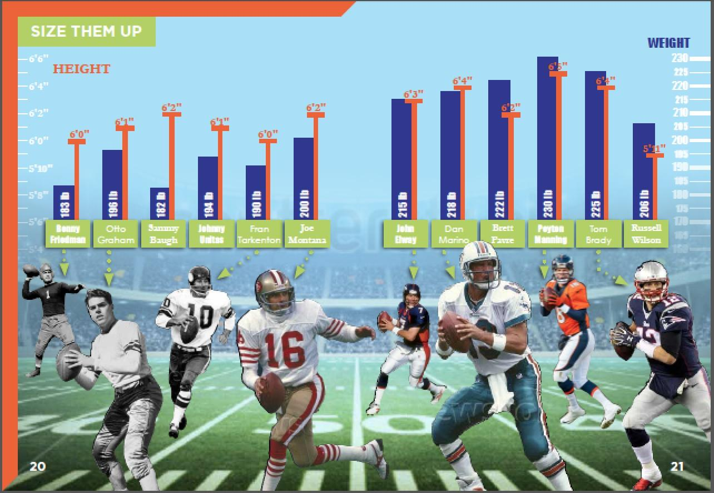
Franchise Mission Statement:
Mission Purpose:
Review the unique qualifying statistical qualities of all potential NFL prospects and comprise a team you believe is most suitable to win it all!
Notes:
Goals
Changed the standard format
Base teams off the most productive point earners, aka rushing yards
Explain a typical loss of points, wrap in injury report, likelihood probability history

Slide 3
Instructional Game Plan/Strategy
Pre-Loaded Data
Extract NFL Player Data
Transform Data to get Top Players & Injury Information
Load Tables to Database
User-Loaded Data
Build Custom Team & Load to Database
Notes:
JACOB. MIX **Instructions on how to use and interact with the project

Slide 4
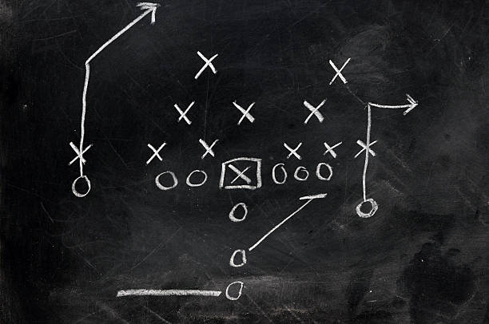
The X’s & O’s Breakdown
The Database Used: Postgresql
Stability
Security
Rich Set of Features
(Joins, Searching, Sorting, Filtering)
User-Friendly
Notes:
**Documentation of the database used and why (e.g. benefits of SQL or NoSQL for this project)

Slide 5
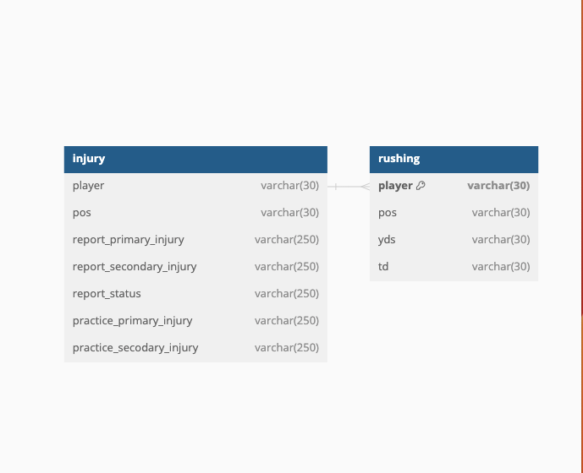
Trust the Process #Workflow
Extract original data
Run Data Clean Up
Transform it to Easily Link Players with Their Injury Reports
Create Database Using Schema File for Filtering, & Sorting Favorite Players
Run Build_Team Notebook to Create Team & Automatically Push Results to CSV & Postgres DB
Notes:
JOHNNY SLIDE
Extract original data
Transform it to easily join best players with their injury reports
Create database using schema file for filtering, and sorting favorite players
Run build_team notebook to create team and automatically push results to csv and postgres db
1. Run Data_cleaning.ipynb
- this will output injury_cut, injury_cleaned and rushing_cleaned csv files to the output_data directory
- Run the fantasy_schema.sql file in your pgAdmin application.
- Import rushing_cleaned.csv into rushing table.
- Import either injury_cut.csv or injury_cleaned.csv into the injury table.
- injury_cleaned.csv removes all null values and duplicates from the injury dataframe.
- some may want to injury_cut to see which players are more injury prone.
2. Run Build_Team.ipynb
- In this file you will see a list of players with top rushing yards sorted by their position. The reason for this is for anyone to quickly get a list of top offensive players to add to a team.
- For more complex searches and sorting I recommend using the postgres tables created above. The dataframes created in Build_Team are for ease of use functionality.
- Execute pick players function
- Enter player first and last name (Player name must be capitolized) in the input field.
- Type ‘done’ if you only want to add a couple of players to your team.
- You are allowed to add up to 6 players on a team.
- A team name is required, do not use spaces.
- Once complete your team will automatically be output to a csv file in the output_data directory

Slide 6

Limitations
PETL Library
Loaded All Data as String Values
Could Not Convert Table from Data Type Object
This Made it a Challenge to Drop Null Values
Finding the most recent data
Notes:
NECOLE SLIDE

Slide 7

Review on the Play - Clear Intentions
"This Broadcast has Copyrighted by NFL Productions for the Private use of our audience, Any other use of this telecast or any pictures, descriptions, or accounts of this game without the consent of NFL Productions is prohibited."
While the NFL is a private entity, the service provided (aka the sport and entertainment of American Football) is very public.
From an uninterested passerby to an avid fan, or a professional scout during the season, everyone has equal observational capabilities and rights to record information of the game.
When we take this notion and compound it with our clear intent, it is clear we are operating and navigating through the data ethically

Slide 8

GO TEAM!
TOUCHDOWN!
Notes:
Thank you for listening to our presentation! The end!

Slide 9
References:
https://www.kaggle.com/datasets/jpmiller/nfl-competition-data?resource=download
https://www.kaggle.com/datasets/aryashah2k/beginners-sports-analytics-nfl-dataset/code
https://tkdocs.com/tutorial/index.html
https://docs.python.org/3/library/tkinter.html

